Slide 1
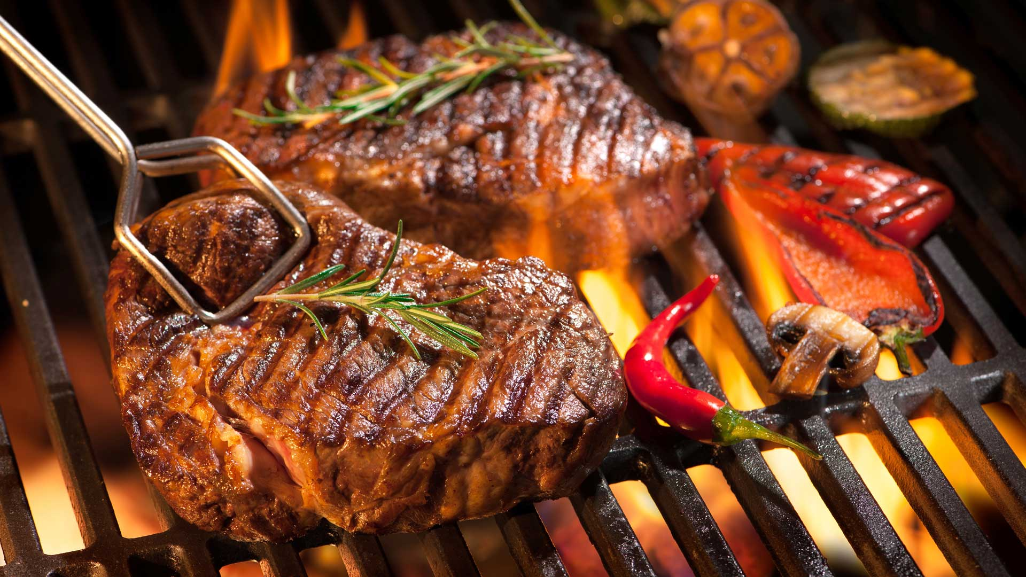
BBQ Reserver
Use Cases
Team 8: K.Kuyan, A.Kialbekov, B.Zhetpisbaev

Slide 2
Before we start...
Time slot - the time unit for reservation a BBQ zone. In the period 8 AM - 6 PM equals two hours. In the period 6 PM - 12 AM equals three hours.
Spreadsheet - Google Spreadsheet
Waiting list - list of users who wants to reserve time slots that already booked but, can be available if owners of the reservation will cancel the reservation.
Notes:
Kirill: Before we start, we would like to introduce key use cases glossary. Time slot refers to the time unit of BBQ reservation and measured in hours intervals. The spreadsheet is a short abbreviation for Google Spreadsheet service. Waiting list - is a list of users, who want to reserve time slots that already booked.

Slide 3
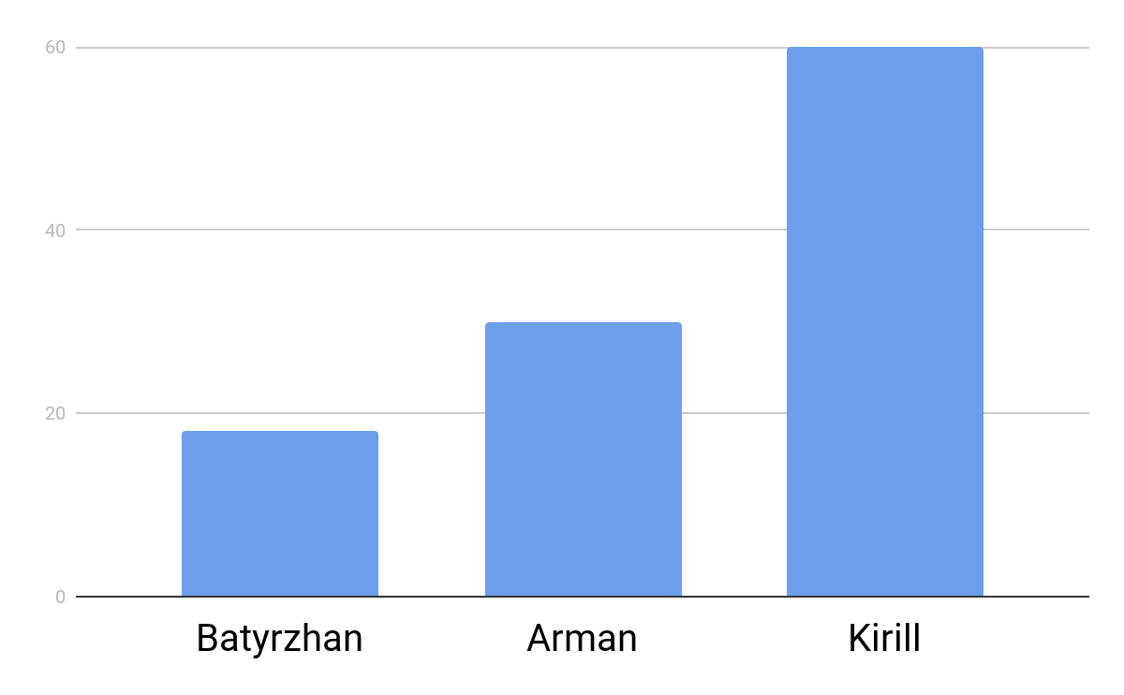
Interview
3 interviews
~25 questions
average 36 minutes
Notes:
Kirill: I have the most longspun interview, because of changes in the elicitation questions, during the interview. We discuss the main points with deviation from the prepared questions template. Also, we mentioned stakeholder experience in software engineering and alternatives solutions.

Slide 4
Conflicts and Resolution
- One more meeting with all members of both teams
- Questions prepared to clarify uncertain points

Slide 5
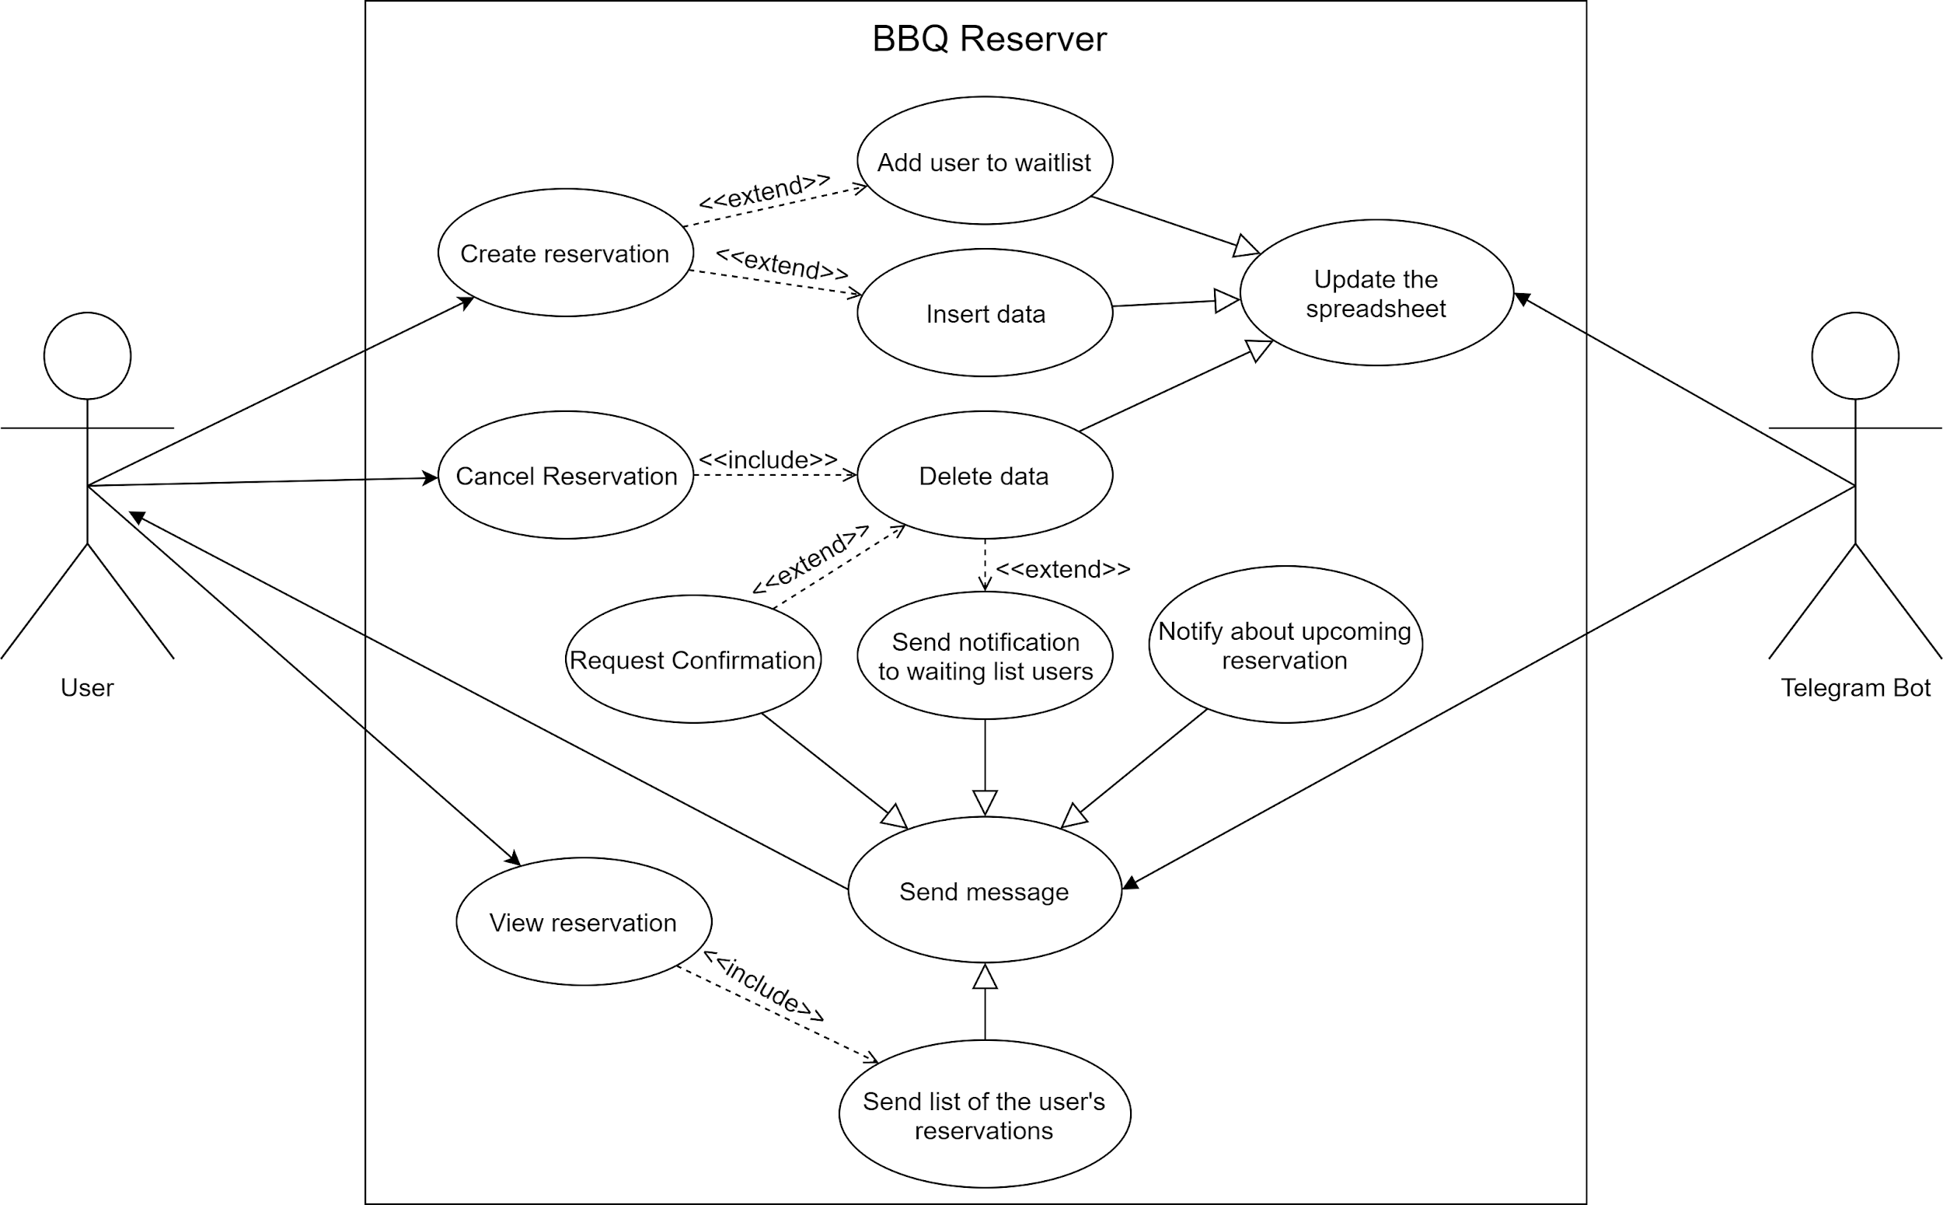
Notes:
Kirill: After meeting and conflicts resolution process, we create a BBQ Reserve use case diagram. The system has two primary actors who are telegram user and bot. The user has three main functions such as the creation, cancelation, and observation of reservations. On the other side, telegram bot provides the functionality of spreadsheet data updates and notifications push.

Slide 6
Create reservation
use case
Use Case Name: | Create reservation
Primary Actors: | Telegram user
Secondary Actors: | Telegram bot
Brief description: | The user creates reservation by selecting an available date and time.
Preconditions: | The user already has: less than 1 reservation for the selected day less than 3 reservation for the selected week less than 12 reservation for the selected month
Flow of events: | The user selects the option to create a reservation. The bot returns a list of available dates: today tomorrow the day after tomorrow. The user selects the date. The bot returns the list of time slots for the selected date.
Postconditions: | The bot provides the list of time slots for the selected date and option to be added to the waitlist.
Alternative flows and exceptions: | The user cannot create a reservation if he has reached the limit for the maximal number of reservations.

Slide 7
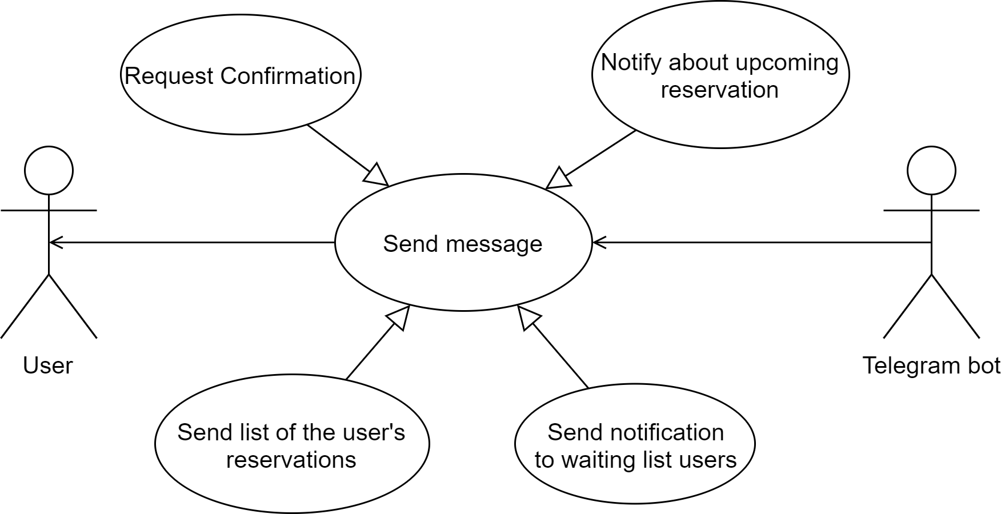
Send
message
use case
Use case name: | Send message (abstract use case)
Use case ID: | SM-10
Brief description: | The bot makes updates in the spreadsheet.
Flow of events: | The bot finds the user. The bot sends a message.
Postconditions: | The message is sent to the user.
Priority: | High
Issues: | The bot cannot send message to the user if he closes the chat.

Slide 8
Lessons learned
- Different stakeholders see the project from different angles
- More uncertainties arose during use case diagram creation
- Requirements are negotiable
Notes:
Kirill: What have we learned during requirements gathering? First, according to the conflicts in interview transcripts, even stakeholders from one team can have different viewpoints in product realization. Second, in the process of use case diagram creation, more uncertainties can arise. In the last one, the initial requirements are negotiable and there is possible to meet the common grounds.

Slide 9
Relevant Questions
Experience of system-as-is
Expectations from system-to-be
Suggestion for future improvements

Slide 10
Thanks for your attention

